Slide 1
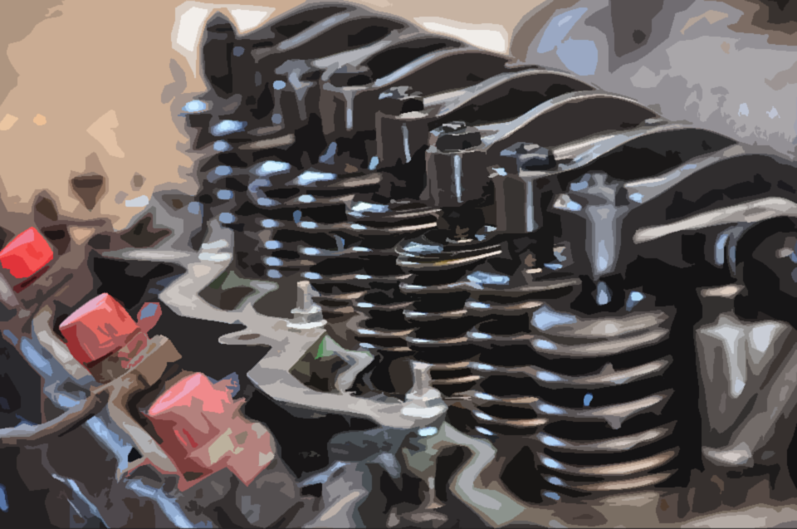
LB
Lubrisy.

Slide 2

Lubrisy.

Slide 3




BETA
A creative commons proyect.
Developed by Pluzi.

Slide 4
LB

Slide 5





